Slide 1
Dsa 210 Project
Ali Serhat Koç 28335

Slide 2


Data Set
Spotify
Visualcrossing

Slide 3
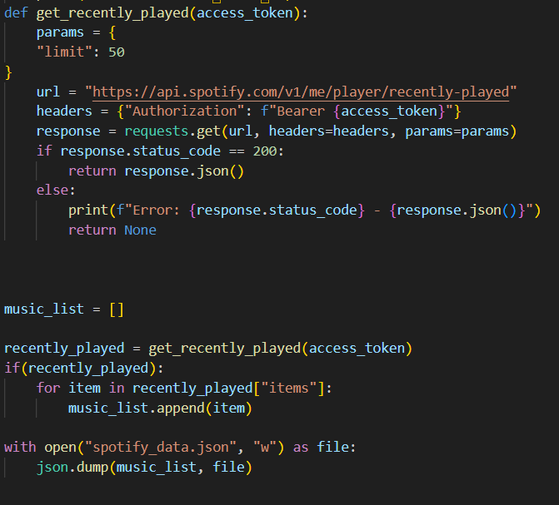
FIRST STEP
I used Spotify API to access my last listened songs.
I had a problem here because Spotify was constantly asking for authentication. To solve this, I saved my data to a json file after accessing it.

Slide 4
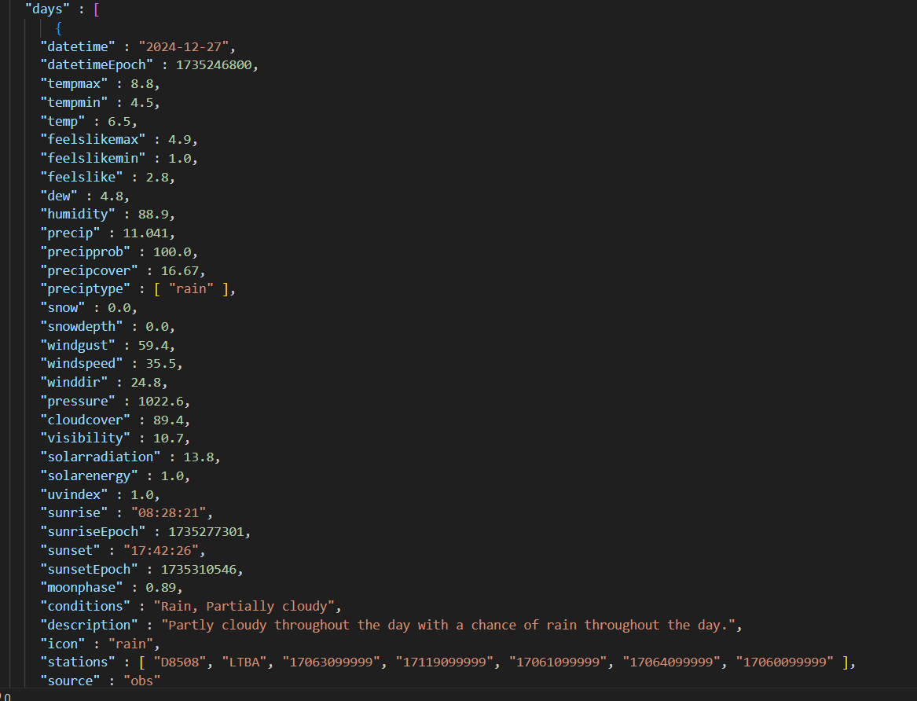
Weather Api
To get weather information, I filtered the dates using the Visualcrossing app and downloaded the data

Slide 5
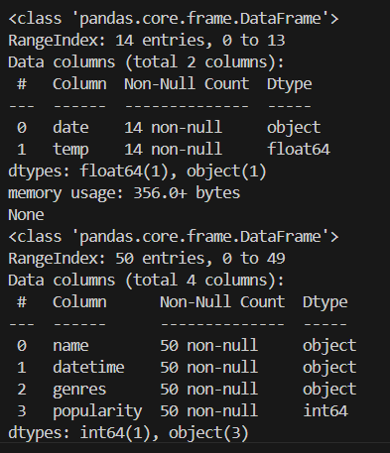
Df.Info()
I checked my data with df.info to analyze if there is a problem with the data I have accessed.

Slide 6
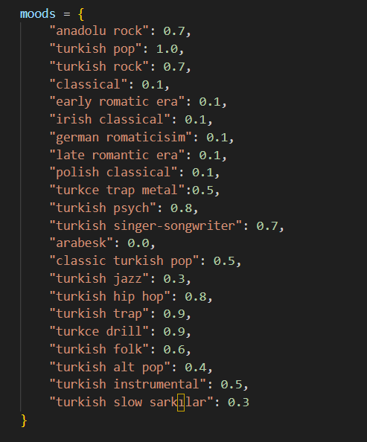
Mood Analysis Update
I wanted to do mood analysis in my project. But when I started collecting data, I saw that the audio features api request depricate on the spotify api site, which has values ​​such as energy and tempo of the songs.
Instead, I pulled the genres of the songs with the API and gave them manual grades between 1 and 0. (1: Energetic mood, 0: Calm mood)

Slide 7
My Hypothesis
There is no significant relationship between weather conditions and mood points

Slide 8
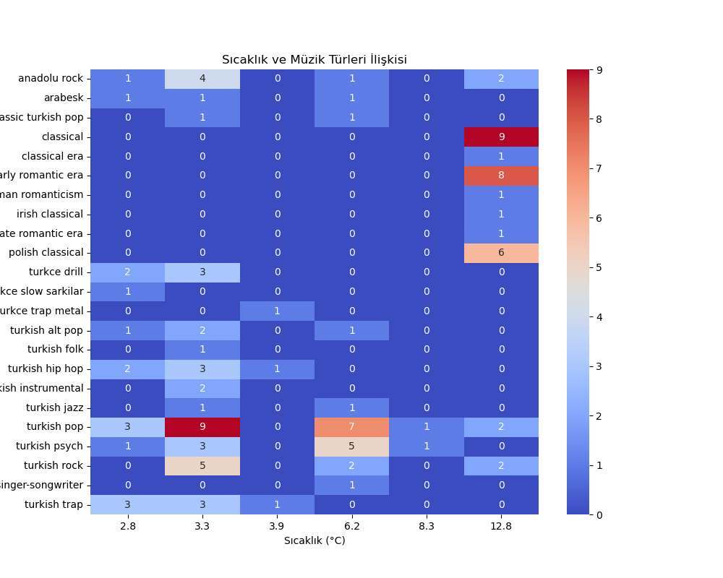
I was expecting the song moods to increase as the temperature increased, but the exact opposite happened.

Slide 9
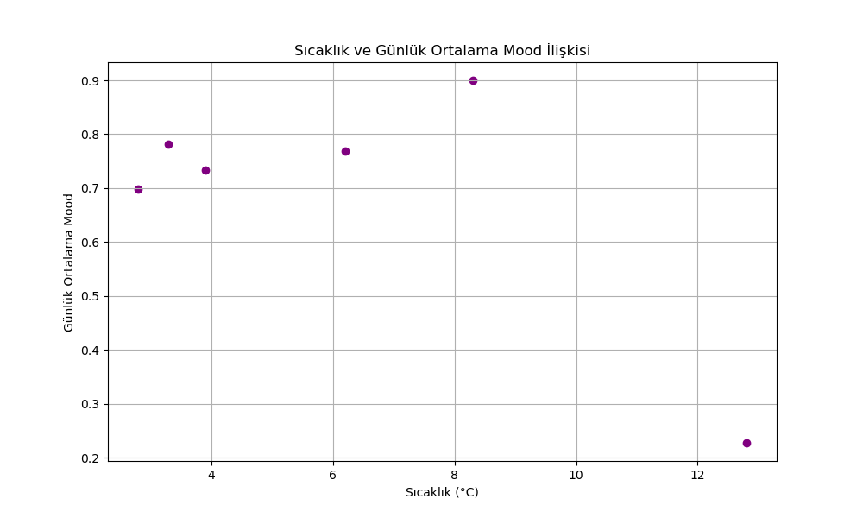
I was expecting the song moods to increase as the temperature increased, but the exact opposite happened.

Slide 10
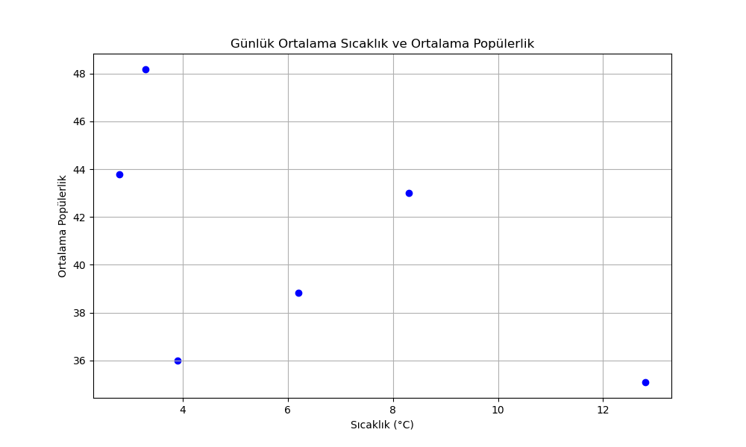
I also analyzed the popularity and temperature of the songs to see if the popularity of the songs I listened to increased as the temperature increased.

Slide 11
Conclusion
Accept H0
It seems there are no significant relations between weather and mood

